Slide 1
Minnesota Labor Standards and the Wage Theft Prevention Act

Slide 2
Labor Standards Enforced by MN DLI
Minnesota Fair Labor Standards Act
Women’s Economic Security Act
Child Labor Standards Act
Minnesota Prevailing Wage Act
Wage Theft Prevention Act
Other laws related to employment,
wages, conditions, hours.
Notes:
Discuss big picture – how this helps worker, how this helps business

Slide 3
Labor Standards/Wage & Hour Agencies in MN
Minnesota Department of Labor and Industry, Labor Standards
www.dli.mn.gov or 651-284-5075
U.S. Department of Labor, Wage and Hour Division
www.dol.gov/whd or 612-370-3341
Minnesota Attorney General's Office
www.ag.state.mn.us or 651-296-3353
Saint Paul, Labor Standards Enforcement and Education Division
www.stpaul.gov/departments/human-rights-equal-economic-opportunity or 651-266-8900
Minneapolis, Labor Standards Enforcement Division
www.ci.minneapolis.mn.us/civilrights/LaborStandardsEnforcement/ or 612-673-3012
Duluth, City Clerk's Office
https://duluthmn.gov/city-clerk/ or 218-730-5500
Notes:
Discuss big picture – how this helps worker, how this helps business

Slide 4
State law – Hours worked
The minimum wage must be paid for all hours worked.
Hours worked include:
training time
call time
cleaning time
waiting time
travel time
Notes:
*travel time is not always considered work time.

Slide 5
State law – Deductions from wages
Allowed deductions from employees (direct or indirect):
Written agreement to deduct insurance payments, union dues, retirement plans, organization or PAC contributions, or savings plans
Up to $50 for uniform(s), equipment
Consumables and travel expenses
Employee voluntarily authorizes the deduction in writing or held liable in court. Authorization must state the amount deducted each pay period.
Notes:
Uptown Drink (Spin and Drink bar nightclubs in Minneapolis took cash register shortages from employee tips (750 employees, MN Supreme Court Case, order to pay back over $700,000.)

Slide 6
State law – Deductions from wages
Allowed deductions from employees: (continued)
Purchase/loan: authorization required, can be made PRIOR to purchase/loan.
Deductions cannot bring the employee below the minimum wage.
The employer must reimburse several types of deductions upon separation.

Slide 7
Final wages upon separation of employment
Employees terminated, discharged, or fired are due all wages and commissions within 24 hours of a written demand for payment.
For employees who voluntarily leave employment, wages and commissions are due on the next regularly scheduled payday. If the payday is within five days of the last day of work, the employer has up to 20 days to make final payment.
Penalties: The employer may be liable to pay their former employee’s average daily earnings for up to 15 days the employer is late paying wages.
Notes:
A 2017 survey conducted by the University of Minnesota found that 33% of Minnesotans had personally or knew someone who had been paid less than the minimum wage in effect at the time in a job they held.

Slide 8
Overtime
Minnesota law: Over 48 hours
This is a general guideline that applies in most situations. DLI refers many overtime cases to the U.S. Department of Labor because the general federal threshold is lower.
Federal law: Over 40 hours
This is a general guideline that applies in most situations. The U.S. Department of Labor should be contacted for further details.
Notes:
Healthcare exception.
Agriculture differences:
In a January settlement with the Minnesota Department of Labor and Industry, Hader Farms of Zumbrota, Minn., agreed to pay workers $17,633 in back overtime wages. In 2012, the Minnesota Appeals Court ordered Daley Farms of Lewiston, Minn., to pay $86,385 in back overtime wages to employees.

Slide 9
Overview
Effective dates of the new laws
New employer responsibilities
Clarification of wages and commissions – what must be paid and when
Retaliation prohibited
Responsible contractor requirements
DLI and Attorney General enforcement authority
Crime of wage theft
Notes:
Discuss big picture – how this helps worker, how this helps business

Slide 10
Effective dates of the Wage Theft Prevention Act
Criminal provisions went into effect Aug. 1, 2019.
Everything else went into effect July 1, 2019.

Slide 11
Employee notice

Slide 12
Employee notice
The employee notice must provide:
Employee's employment status and whether an employee is exempt from minimum wage, overtime and other state wage and hour laws, and on what basis.
For information regarding who can be considered exempt, as well as information regarding other exceptions that may apply to minimum wage and overtime, reference Minnesota Statues 177.23 and Minnesota Administrative Rules, Chapter 5200.0180 through 5200.0220.
Number of days in the employee's pay period and the regularly scheduled payday.
Date the employee will receive the first payment of wages earned.

Slide 13
Employee notice
The employee notice must provide:
Employee's rate or rates of pay and the basis thereof, including whether the employee is paid by the hour, shift, day, week, salary, piece, commission or other method and the specific application of any additional rates.
Allowances, if any, that may be claimed for permitted meals and lodging.
For further information regarding meal and lodging allowances reference Minnesota Rules, Chapter 5200.0060 and 5200.0070.

Slide 14
Employee notice
The employee notice must provide:
Provision of paid vacation, sick time or other paid time off (PTO), how the paid time off will accrue and terms for its use.
A list of deductions that may be made from the employee's pay.
Employer's legal name and the operating name, if different.
Physical address of employer's main office or principal place of business and a mailing address, if different.
Employer's telephone number.

Slide 15
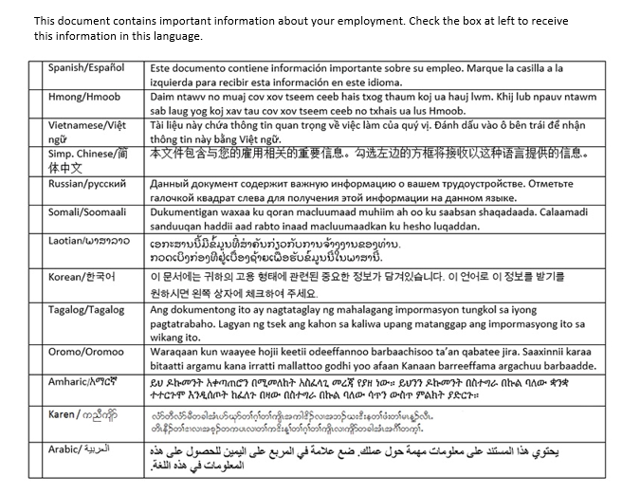
Employee notice
All employers must provide the notice to employees in English. The notice must include a statement, in multiple languages, that informs employees they may request the notice be provided to them in another language.
The employer must provide the notice in another language if requested by the employee.

Slide 16
Employee notice
Employers are required to keep a copy of the notice signed by each employee.
Employers are also required to provide employees in writing any changes to the information in the notice before the date the changes take effect.

Slide 17
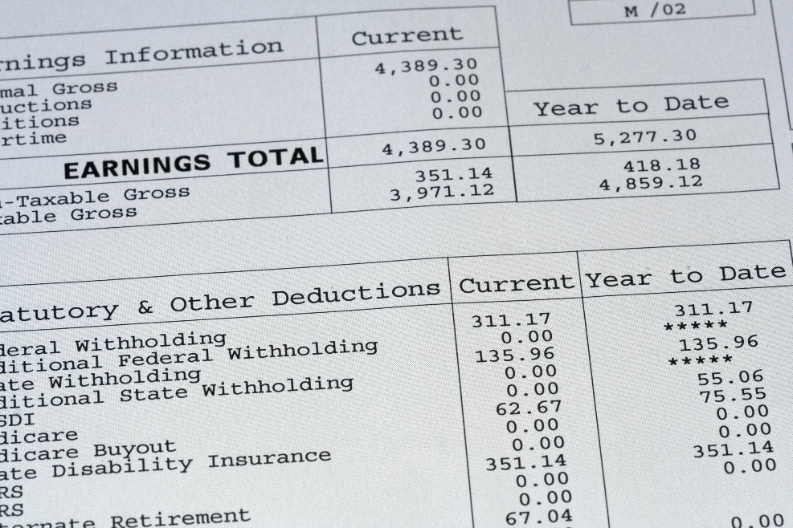
Earnings statements
Earnings statement requirements:
Name of the employee.
Total hours worked by the employee in the pay period.
Total amount of gross pay earned by employee in the pay period.
Net amount of pay after all deductions are made.
List of deductions made from the employee's pay.
Date pay period ended.
Employer's legal and operating name.

Slide 18
Earnings statements
Additional earnings statements requirements:
Employee's rate or rates of pay and basis thereof, including whether the employee is paid by the hour, shift, day, week, salary, piece, commission or other method.
Allowances claimed for permitted meals and lodging.
For further information refer to Minnesota Rules, Chapter 5200.0060 and 5200.0070.
Employer's telephone number.
Physical address of employer's main office or principal place of business and a mailing address, if different.

Slide 19
Recordkeeping
Recordkeeping requirements:
Employee's name, address and occupation.
Employee's rate(s) of pay and the amount paid each pay period.
Employee's hours worked each day and each workweek.
Certified payroll (for prevailing-wage projects only).
Other information the commissioner finds necessary and appropriate to enforce Minnesota Statutes §§ 177.21 to 177.435.

Slide 20
Recordkeeping
Additional records employers are now required to maintain:
Employee's hours worked each day and each workweek, including, for all employees paid at piece rate, the number of pieces completed at each piece rate.
A list of the personnel policies provided to the employee, including the date the policies were given to the employee and a brief description of the policies.
A copy of the employee notice. Plus, a copy of any written changes to the notice that were provided to each employee.

Slide 21
Recordkeeping
Records must be available for inspection upon demand from the Department of Labor and Industry (DLI).
Records must be either kept at the place where employees are working or kept in a manner that allows the employer to comply with the demand within 72 hours.
If records maintained by the employer do not provide sufficient information to determine the exact amount of back wages due, DLI may make a determination of back wages due based on available evidence.

Slide 22
Clarification of "wages" and "commissions"
Clarifications and requirements for what wages and commissions an employer must pay and when employers must pay wages and commissions to employees:
Employers must pay all wages, including salary, earnings and gratuities earned by an employee at least once every 31 days and all commissions earned by an employee at least once every three months on a regular payday.
The new Wage Theft Law further clarifies that Minn. Stat. § 181.101 provides a substantive right to the payment of commissions and wages, at the employee's rate or rates of pay or the rate or rates required by law, whichever is greater, as well as the right to be paid wages and commissions earned on a regular pay day.

Slide 23
Retaliation prohibited
An employer is prohibited from retaliating against an employee for asserting rights or remedies under the Minnesota Fair Labor Standards Act, the Minnesota Prevailing Wage Act and certain provisions of Minn. Stat. Chapter 181 (Payment of Wages Act), including filing a complaint with DLI or telling the employer of the employee's intention to file a complaint.
In addition to any other remedies provided by law, an employer that violates this subdivision is liable for a civil penalty of $700 to $3,000 for each violation.

Slide 24
Responsible contractor requirements
The "responsible contractor" requirements have been amended to include Minn. Stat. §§ 181.03 (prohibited wage practices and retaliation), 181.101 (payment of wages) and 609.52, subd. 2 (19) (criminal wage theft), in the list of laws that contractors must verify they are in compliance with and have not violated during the past three years, to be considered eligible to bid on public contracts.

Slide 25
DLI enforcement authority
The application of remedies under existing law was clarified and penalty amounts were increased for repeated violations of the recordkeeping laws. The commissioner's enforcement authority was also clarified and expanded:
Enter and inspect places of employment without unreasonable delay to carry out purposes of Minn. Stat., Chapters 177, 181, 181A and 184.
Apply for an inspection order in district court in the county where the place of employment is located to require employer to permit entry of the commissioner or an authorized representative if the entry has been denied.
Interview nonmanagement employees in private regarding an investigation.
25

Slide 26
DLI enforcement authority
DLI, its commissioner or its authorized representative shall provide a copy of an order to comply issued to an employer and the disposition of the order or the data set out in the order to comply and its disposition to the following entities:
A licensing or regulatory authority of one or more state agencies or agencies of political subdivision to which the employer is subject.
A public contracting authority with which the employer is party to a public contract.
The employees whose interests are affected by the order.
26

Slide 27
Attorney general enforcement authority
The Minnesota Attorney General’s Office, in addition to the Department of Labor and Industry, has the authority to enforce Minn. Stat., Chapters 177 (Minnesota Fair Labor Standards Act and Prevailing Wage Act) and 181 (Payment of Wages) under Minn. Stat. § 8.31.

Slide 28
Criminal wage theft
The crime of "wage theft" occurs when an employer, with intent to defraud:
Fails to pay an employee all wages, salary, gratuities, earnings or commissions at the employee's rate or rates of pay or at the rate or rates required by law, whichever is greater.
Directly or indirectly causes any employee to give a receipt for wages for a greater amount than that actually paid to the employee for services rendered.
Directly or indirectly demands or receives from any employee any rebate or refund from the wages owed the employee under contract of employment with the employer.
Makes or attempts to make it appear in any manner the wages paid to any employee were greater than the amount actually paid to the employee.

Slide 29
Criminal Wage Theft
“Employer” and “employee” are defined broadly under criminal law:
“Employer” is defined as “any individual, partnership, association, corporation, business trust, or any person or group of persons acting directly or indirectly in the interest of an employer in relation to an employee.”
“Employee” is defined as “any individual employed by an employer.”

Slide 30
Criminal Wage Theft
Sanctions for committing wage theft :
Wages stolen (per employee*) | Max Prison Sentence | Maximum Fine
More than $35K | 20 Years | $100,000
$5K - $34,999 | 10 years | $20,000
$1K - $4,999 | 5 years | $10,000
$500 - $999 | 1 year | $3,000
*When determining the value of the wages stolen, the law allows for the amount of employee wages that were stolen through wage theft to be aggregated within any six-month period.

Slide 31
For more information
Visit our web site at www.dli.mn.gov/laborlaw.
Sign up for the Wage and Hour Bulletin on our website.
Contact DLI’s Labor Standards at 651-284-5075 or dli.laborstandards@state.mn.us.

