Slide 1
Grants
Michael Crider

Slide 2
AGENDA
Pell Grant
Iraq & Afghanistan Service Grant
Children of Fallen Heroes Scholarship
TEACH Grant Program
FSEOG – Supplemental Educational Opportunity Grant
MN State Grant (Minnesota Financial Aid)

Slide 3
Pell Grant
FAFSA required
Enrolled in at least 1 credits or more (for credit hour programs)
Must determine eligibility before awarding other federal aid
Undergraduate students only (no previous degrees)
Scheduled awards assume full-time enrollment – 12 credits
Schools must determine what formula they are required to use based on programs offered
Notes:
Credit-hour programs for calendars of semesters, trimesters, and quarters.
Qualify for formula 1 but have less than 30 weeks of instruction between fall and spring (rarely used)
Credit hour programs with non-standard terms. Can use this one for any term-based credit-hour program even if it qualifies for 1 or 2. If summer has less than 12 hours, school has to use formula 3 for all terms
All clock-hour programs or credit hour without terms
All correspondence programs

Slide 4
Year-Round Pell
Each term the Pell Grant is received at FT enrollment = 50%
(Fall + Spring = 100%)
Year-round Pell exceeds 100%
Ex. Student attends summer term
Can receive up to 150% Pell grant in one school year
Student no longer need to be enrolled at least half-time (removed requirement beginning 24-25)

Slide 5
Pell Grant LEU
Lifetime Eligibility
Students become ineligible for Pell or Iraq & Afghanistan Service Grant funds once they have reached or exceed the 600% or 12-semester equivalency limit for the applicable program.
Schools must report Pell Grant disbursement information to COD no later than 15 calendar days after making a disbursement or adjustment.
If a student’s usage is more than 500% but less than 600% they have partial year of Pell grant eligibility
Notes:
Pell & Iraq &Afghanistan Service Grant at separate and tracked independently
Needs to be tracked by the school as well through COD.

Slide 6
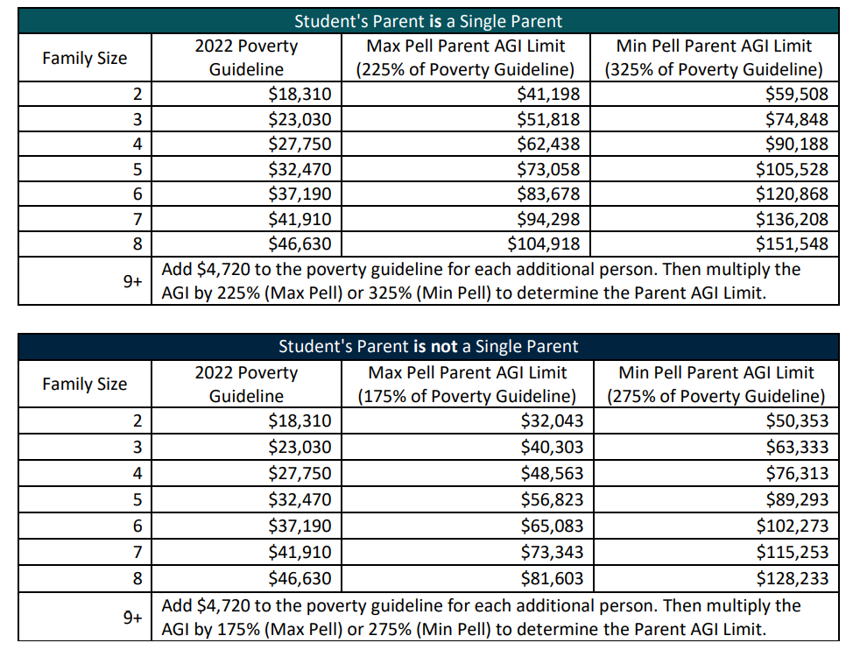
24-25 Pell Grant
Determine if student falls within eligibility limits
Dep student’s parent’s state of legal residence
Is the student’s parent a single parent?
Reference the appropriate table to locate the row that corresponds to the student’s family size
Notes:
https://fsapartners.ed.gov/sites/default/files/2023-05/202425DRAFTSAIGuideSupplementEligibilityforMaxorMinPellGrantResource.pdf

Slide 7
24-25 Pell Grant
If parents’ 2022 AGI >$0 but <= the Max Pell AGI limit for their family size, the student is eligible for Max Pell
If student is not eligible for Max Pell and parents’ AGI <=Min Pell AGI limit for their family size, student is eligible for Min Pell
Student may qualify for a different Pell Grant amount based on their SAI
Award amounts will be impacted by enrollment status and lifetime Pell limits
Notes:
Same eligibility and calc is true for independent students but based on their information and appropriate tables (additional table for “not a parent”). Separate tables for Hawaii and Alaska

Slide 8
24-25 Pell Grant Calculation
Three Pell outcomes for eligible students
Automatic Max Pell
The difference between Annual Max Pell and the student’s SAI (round to the nearest $5)
Minimum Pell (10% of Max Pell)
If scheduled award exceeds COA, must be reduced
Notes:
Max and Min amounts have not yet been announced.

Slide 9
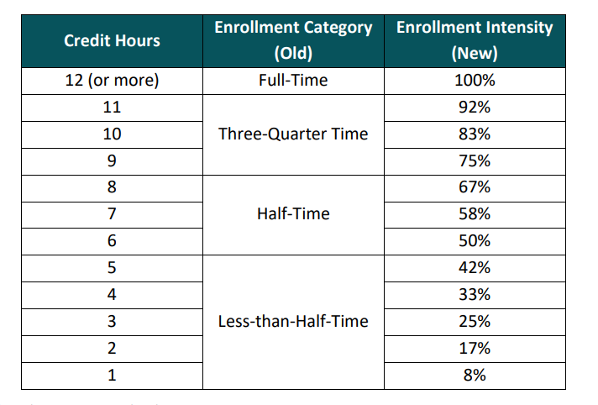
24-25 Pell Grant Enrollment Intensity
Percentage of full-time enrollment at which a student is enrolled.
Ex. If FT = 12 credit hrs and student is enrolled in 7, enrollment intensity = 7/12*100%=58%
Programs with non-standard terms = multiply the # of weeks in each term by the # of credit hours, then dividing by the # of weeks in an academic year

Slide 10
24-25 Pell Grant Formulas
Formula 1 – Credit Hour Programs Using Standard Terms
Annual Pell Award is divided by # of terms in the fall through spring for a school with a traditional academic calendar
Formula 2 – Standard Term Programs with Less than 30 weeks in the fall through spring
Scheduled Pell is prorated based on the # of weeks in the academic calendar to determine the Annual Pell Award. The Annual Pell Award is then divided by the # of terms in the fall through spring
Notes:
https://fsapartners.ed.gov/sites/default/files/2023-05/202425DRAFTSAIGuideSupplementPellFormulasandEnrollmentIntensity.pdf

Slide 11
24-25 Pell Grant Formulas
Formula 3 – General Formula for Any Term Based Program
Any term-based program can use this formula but must be used for a term-based program that doesn’t qualify for formulas 1 or 2.
Prorated based on the # of weeks of instructional time in each term in the academic year. Calculated by term rather than the full year.
Notes:
https://fsapartners.ed.gov/sites/default/files/2023-05/202425DRAFTSAIGuideSupplementPellFormulasandEnrollmentIntensity.pdf

Slide 12
24-25 Pell Grant Formulas
Formula 4 – Clock Hour and Non-Term Credit Hour Programs
Annual award is the full-time scheduled award, even if the student is attending < full-time
Paid in installments to help meet the student’s cost in each payment period. Payment period determines when and how much is disbursed
Formula 5 – Correspondence Study
Contact your Financial Aid Office
Notes:
https://fsapartners.ed.gov/sites/default/files/2023-05/202425DRAFTSAIGuideSupplementPellFormulasandEnrollmentIntensity.pdf

Slide 13
Iraq & Afghanistan Service Grants
Non-need-based grants
Parent or guardian died as a result of U.S. military service in Iraq or Afghanistan after 9/11/2001
AND are not otherwise eligible to receive Pell Grant
Cannot receive both. Pell trumps this grant
Eligibility
Regular undergraduate student enrolled in an eligible program
Less than 24 years old or enrolled in an eligible program at the time of the parent or guardian’s death

Slide 14
Iraq & Afghanistan Service Grants
Amount received is equal to the Pell Grant the student would have received if they had a zero EFC
Adjusted for students who are less than full time
All other federal aid is based on the student’s calculated EFC
Small percentage reduction. Changes each year with the fiscal year beginning 10/1.
5.70% through 10/1/24

Slide 15
Children of Fallen Heroes Scholarship
Eligibility:
Student must be eligible for Pell
Parent or guardian must have died in the line of duty while performing as a public safety officer
Student must have been less than 24 years old or enrolled in college at the time of parent or guardian’s death
Future eligibility relies on Pell eligibility

Slide 16
Children of Fallen Heroes Scholarship
Award = maximum Pell amount based on zero EFC. Regardless of student’s actual EFC
All other Title IV aid must be awarded based on zero EFC
School must collect and maintain documentation from student to establish eligibility.

Slide 17
TEACH Grant
Not need-based
Provides up to $4,000 per student per year
Enrolled in an eligible program that leads to a bachelor’s or master’s degree or in a post-baccalaureate program that will prepare the student to be a teacher.
Must complete the required counseling and sign a service agreement
Notes:
a two-year program, acceptable for full credit toward a bachelor’s degree, is considered a program that leads to a bachelor’s degree

Slide 18
TEACH Grant
Service Agreement – committing to do all of the following after complete their program of study
Teach in a high-need field
Teach at a low-income elementary or secondary school as a highly qualified teacher
Teach for at least four years within eight years of completing the program for which the TEACH grant was awarded
If these requirements are not met, then grant turns into an Unsubsidized Loan and must be repaid
Notes:
Failure to meet the requirements of the service agreement, the grant will be treated as an unsubsidized loan (interest would accrue from the date of disbursement)

Slide 19
FSEOG
Federal Supplemental Educational Opportunity Grant
Funds for under grad students with exceptional need Schools have a lot of autonomy in how these funds are awarded, but must comply with regulatory restrictions
Max amount = $4,000 (study abroad – addt’l $400)
Min amount = $100
Unless an institutional match waiver has been granted, the federal share of FSEOG awards is 75%.
Notes:
Max and min amounts are based on a full award year

Slide 20
FSEOG
Selection Criteria
Two selection groups
Priority order based on Pell eligibility and lowest EFCs
A reasonable proportion of a school’s allocation must be awarded to independent and part-time students
Awarding on a first-come, first-served basis is prohibited, as is setting arbitrary EFC cut-offs

Slide 21
FSEOG
First Selection Group
Lowest EFC who are also receiving Pell Grants during the same award year
Second Selection Group
If remaining funds having awarded all Pell Grant eligible students, must select students with the lowest EFCs who are not receiving Pell Grants for the award year. Including those who have exceed their Pell LEU for the entire award year
Notes:
Doesn’t have to necessarily receive Pell in the same payment period. Ex. If a student has reached their Pell LEU and can only have Pell for fall, they can still have FSEOG for the whole year

Slide 22
Thank You!

